Slide 1
Utilizing expert witnesses to defend sex assault cases
John S. Berry, Berry Law Firm
Mallory N. Hughes, Dornan Law Team
Lincoln and Omaha, NE

Slide 2
Which Experts do you need?
What is your narrative?

Slide 3
The Client
https://www.youtube.com/watch?v=Hg8Oej-m9hc&feature=youtu.be

Slide 4
The HERO
Geochemist
Coast Guard Veteran
Bisexual
Cubs fan
Son of a Police Officer
PTSD from military rescue accident

Slide 5
The Villain
The Juvenile delinquents
The Jersey Chasers
The Angry Ex-Spouses
The Cheaters Caught
The “Virgins”
The Wannabe Victims
The Money-Hungry

Slide 6
Private Investigators
Your investigator’s background
2. Fresh memories
3. Canvass actual scenes
Not following in footsteps of local law enforcement
4. Record witness statements
Example: Alternate cause of injury
5. Cross-examination tips on quality of local law enforcement’s investigation
witnesses

Slide 7
DIGITAL Forensic experts
1. Identification (of possible devices)
2. Preservation (Motions; Independent inspection)
3. Collection (Geolocation data; Recovering deleted data)
4. Analysis (quality of prosecution’s extraction)
5. Reporting (dissecting and presenting in layman’s terms)
6. Shawn Kasal skasal@gmail.com
State & Federal Court; Military Court Martials
Civil & Criminal

Slide 8
Forensic NURSE/S.A.N.E.
Review physical SANE kit & SANE Report (see next slide)
Critique methodology/techniques of SANE who conducted exam
When to make the prosecution’s SANE your friend
Sexual History/STI’s/Injuries and Healing Time
Reveal motives to falsify
Reveal inconsistencies/lies in prior statements
Example: “The Virgin With Chlamydia”
Dr. Jennifer Johnson, jenniferjohnsonforensiclnc@gmail.com
Board-Certified Women’s Health Nurse Practitioner
Board-Certified Advanced Forensic Nurse
SANE

Slide 10
Dna expert
Analyze results
Absence of DNA
DNA in pre-ejaculatory fluid
Anything Forensic Nurse Examiner not qualified to discuss

Slide 11
Psychologist & PSYCHIATRISTS
Quality of Forensic Interviews
Exploring Alternate Hypotheses
Biasing factors
Issues with interrogation/false confession
Scientific discussion re: why children lie (factors that play a role)
Refuting testimony of a State expert re: delayed disclosure
Accuser mental health diagnoses/history of juvenile delinquency
Trauma-informed/“start by believing” interview methods
Daubert
Assisting Trier of Fact/Opinion on Ultimate Issue
Prepping your expert for the Daubert Hearing

Slide 12
sleep specialists
Allegations stemming from middle of the night
Known or suspected sleep disorders
Accuser or Accused
Pieces of allegations that conflict with reality
Sleep cycles
Lack of sleep resulting in intensive dreams/nightmares

Slide 13
Polygraph Expert
Have client take a private polygraph
If client passes, have a polygraph expert review
Notify prosecutor?
Do not consent to a government polygraph
Prepare for Daubert challenge

Slide 14
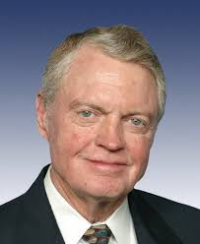
Character “Experts”
INSERT
INSERT
INSERT
INSERT
INSERT

Slide 15
The Real Expert: Your client
Does your client need to explain the “dirty call”
What is on your client’s phone
Did your client provide a statement
What can your client possibly say to help
Risk assessment
Does the client want to testify

Slide 16
EXPERTS FOR MITIGATION
1. Psychosexual Evaluations
2. Mental Health Diagnoses
3. Treating Physicians
4. Jeff Whiting!

Slide 17
Title IX Investigations
Does the client give a statement?
Hire investigator immediately
What evidence do you turn over?
Subpoena the school’s records

Slide 18
The Takeaway
Use your experts to control the narrative
The sooner the better
Advocates for science/the truth
Need materials?

Slide 19
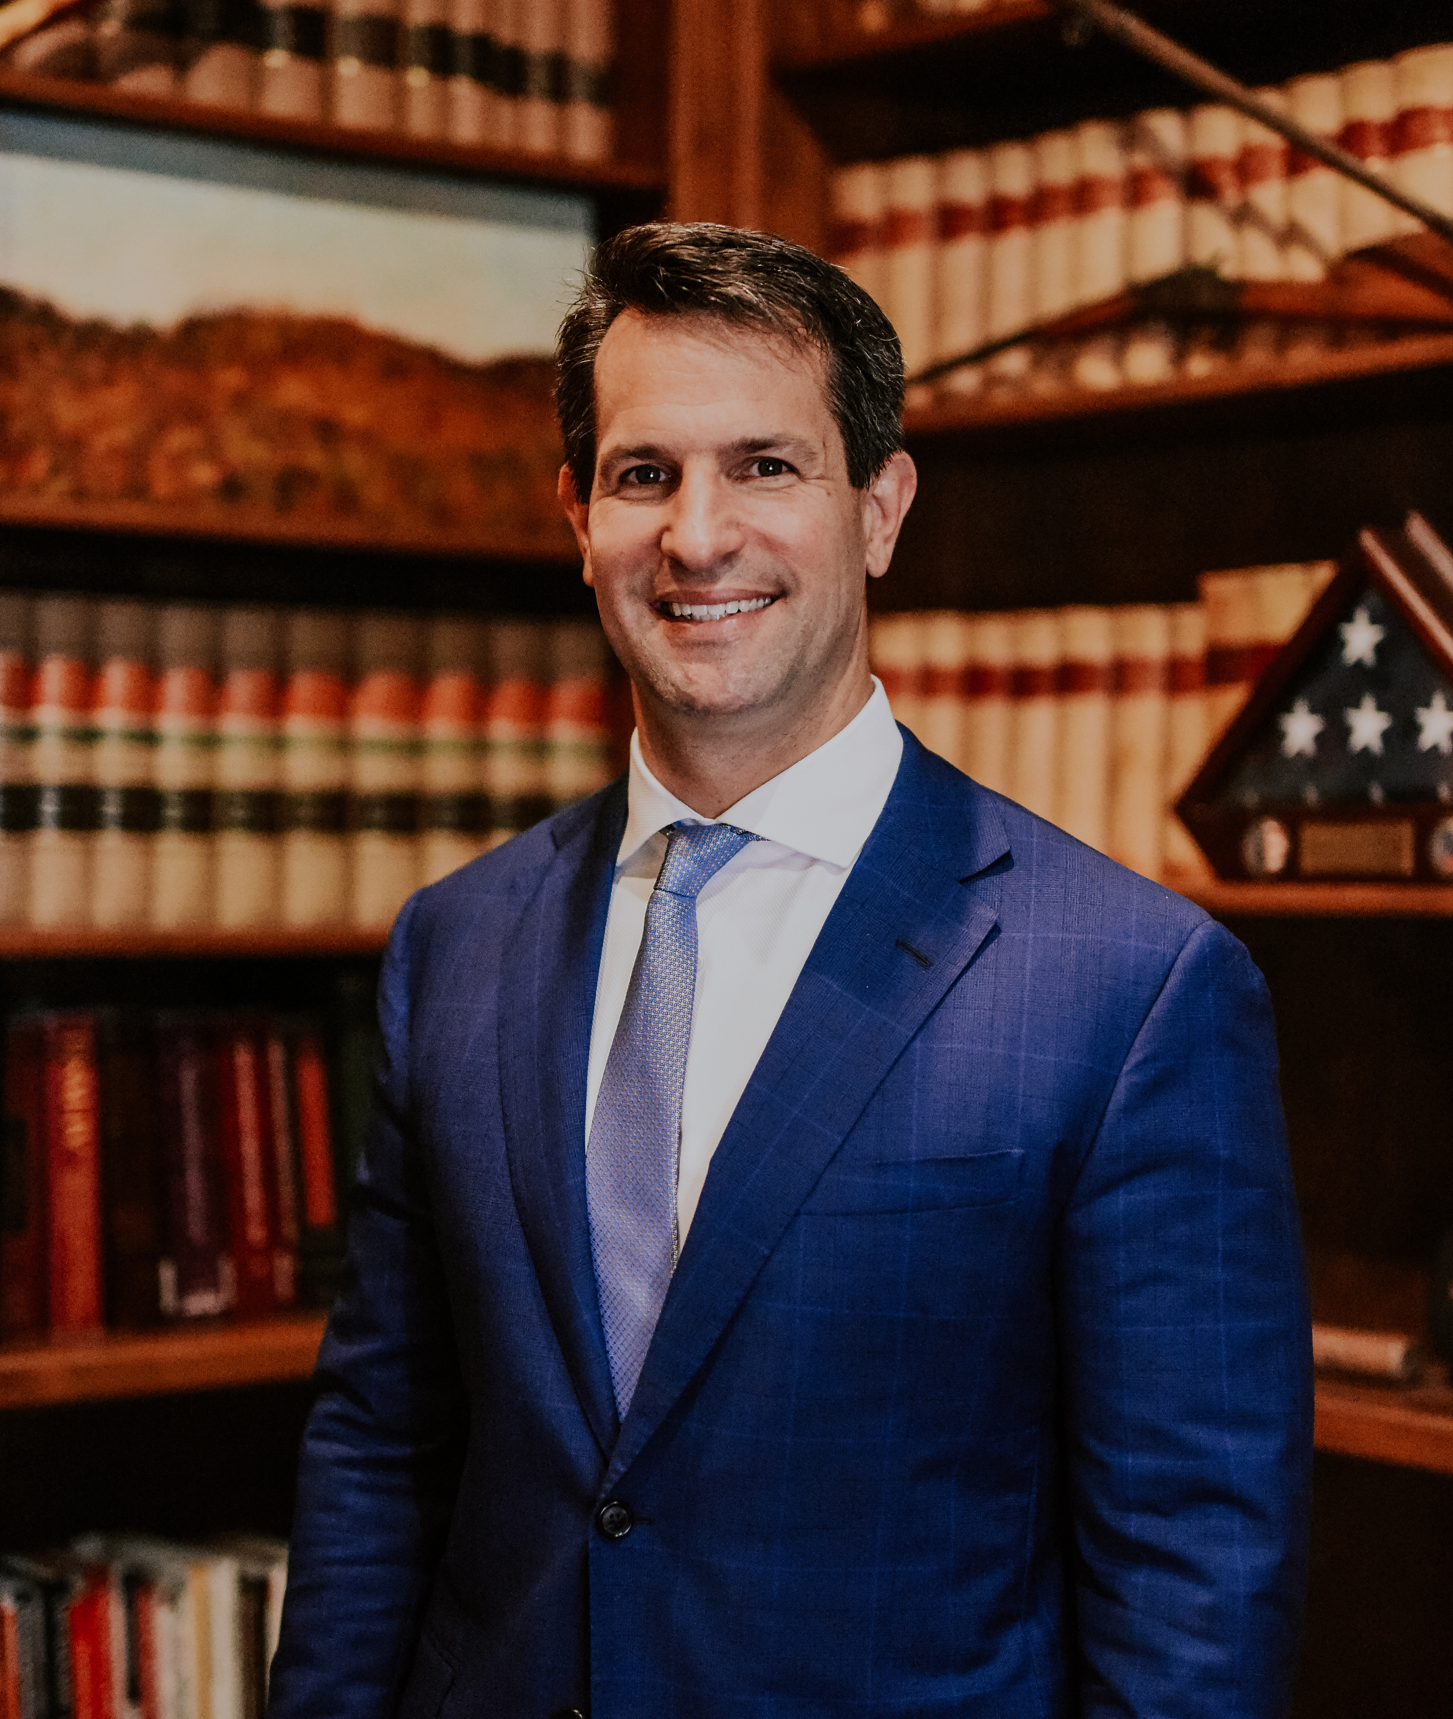
QUESTIONS?
John S. Berry
402-466-8444
john@jsberrylaw.com
www.jsberrylaw.com
Mallory N. Hughes
402-884-7044
mnh@dltlawyers.com
www.dltlawyers.com

