Slide 1
COUNSELING THE COUNSELOR
ETHICAL CONSIDERATIONS OF DEALING WITH A SUICIDAL CLIENT

Slide 2
WHO AM I?

Slide 3
WHO AM I?

Slide 4
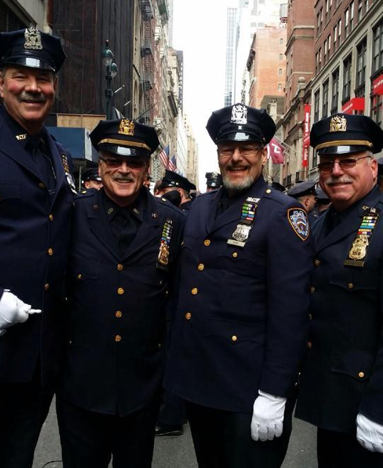
WHO AM I?

Slide 5
I’M GOING TO TALK ABOUT…
Ethical considerations of dealing with suicidal clients
Information to help someone and, maybe, even save a life

Slide 6
WHY DO PEOPLE HELP OTHER PEOPLE?
Reciprocity: quid pro quo.
Spatial selection: proximity relationships.
Same church
Gym
Card Club
Neighbors
Co-workers
Genetic selection: family members.
Indirect reciprocity: the most powerful.
We’ll help you if you’re seen as a desirable person to assist (good reputation, helps others).
Group selection: helping you furthers greater good.

Slide 7
STATISTICS FROM 2014
American Foundation for Suicide Prevention gives the statistic of 42,773 suicides a year in the US, and that number is 5-25% under reported
Military active and veteran 23 a day
2014 Firearms deaths were 33,599 -21,334 of them were suicides (About half of all suicides)

Slide 8
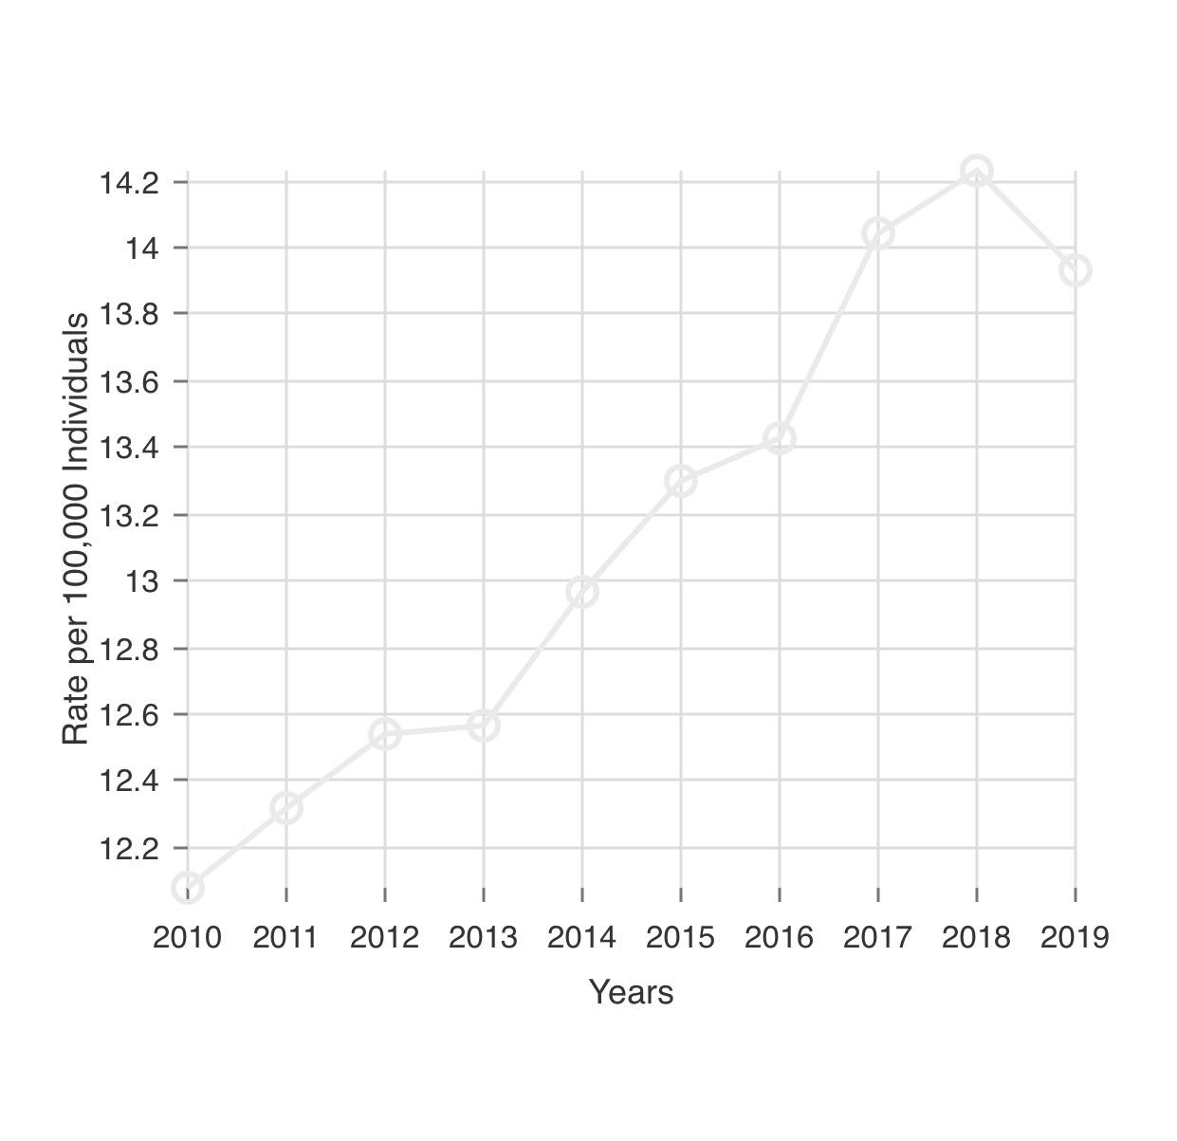
CURRENT STATISTICS
American Foundation for Suicide Prevention
Suicide is the 10th leading cause for death in the US
In 2019, 47,511 Americans died by suicide
In 2019 there was an estimated 1.38 M suicide attempts
In 2015, suicide cost the US $69 Billion
The age-adjusted suicide rate in 2019 was 13.9 per 100,000 individuals.
The rate of suicide is highest in middle-age white men in particular.
In 2019, men died by suicide 3.63x more often than women.
On average, there are 130 suicides per day.
White males accounted for 69.38% of suicide deaths in 2019
In 2019, firearms accounted for 50.39% of all suicide deaths

Slide 9
INVITATIONS THAT SOMEONE MIGHT BE SUICIDAL
HINTS TO LOOK FOR— THEY’RE INVITING YOU TO HELP

Slide 10
ACTIONS
Giving away possessions
Withdrawal from family friends
Abuse of alcohol & drugs
Extreme behavior changes
Reckless behavior
Self-mutilation

Slide 11
FEELINGS
Desperate
Angry
Guilty
Lonely
Sad
Hopeless
Helpless

Slide 12
THOUGHTS
“I wish I were dead”
“I won’t be needing these things anymore”
“I can’t keep my thoughts straight”
“Everyone will be better off without me”
“Now I know what they were going through”

Slide 13
PHYSICAL
Lack of interest in appearance
Change/loss in sex interest
Disturbed sleep
Change/loss of appetite
Physical health complaints

Slide 14
Screening
Once you determine there might be a problem, start with…
Again, are you having thoughts of hurting yourself or others?
If yes, ask the following questions:
When was the last time you felt that way?
Do you have a plan now?
Ask yourself, Is it lethal? Can the client die?
Were there previous attempts? How recent?
How would you do it?
Are you alone right now?
Where are your weapons now?

Slide 15
Things to watch for when assessing potential risk of
·suicide:
Plan- Do they have one?
Lethality- Is it lethal? Can they die?
Availability- Do they have the means to carry it out?
Illness- Do they have a mental or physical illness?
Depression - Chronic or specific incident(s)?
Previous attempts - How many? How recent?
Alone -Are they alone? Do they have a support system? Partner? Are they alone right now?
Loss Have they suffered a loss? Death, job, relationship, self esteem?
Substance Abuse (or use) - Drugs, alcohol, medicine? Current, chronic?

Slide 16
'CAGE“
test for drinking
Have you ever felt you should Cut down on your drinking?
Have people Annoyed you by criticizing your drinking?
Have you ever felt bad or Guilty about your drinking?
Have you ever had a drink first thing in the morning to steady your nerves or get rid of a hangover (Eye opener)?
This brief questionnaire was developed by Dr. John Ewing, National Institute of Alcohol Abuse & Alcoholism.
One "yes" answer suggests a possible alcohol problem. More than one "yes" answer means it is highly likely that a problem exists.
eap- 667-2619. When it's nobody's business but yours, we'll keep it that way.

Slide 17
AFTER REVIEWING THE RISKS, CONSIDER ASKING THE QUESTION: “ARE YOU HAVING THOUGHTS OF SUICIDE?”
WAIT FOR THE ANSWER

Slide 18
FOLLOW THAT UP WITH A DIRECT QUESTION: “DO YOU WANT TO KILL YOURSELF”
AGAIN WAIT FOR THE ANSWER

Slide 19
You want to ask the person WHY they want to kill themselves. Without judgement.
When talking to the person repeat back what they are saying,
“What I hear you saying is you’ve broken up with your girlfriend and that’s why you want to kill yourself”

Slide 20
A FEW THINGS NOT TO DO
Don’t say look what you have to live for, you have a wife, kids, nice house ect.
Those might be the very reason they want to kill themselves.
Please, don’t make light of it.
Omaha Attorney: “If you’re going to kill yourself do it outside so you don’t make a mess.”
Police helicopter above a bridge in NY, “Hey you’re creating a traffic jam, either get down or jump” He jumped .

Slide 21
IF THEY ARE SUICIDAL
Do they have a current suicide plan? - How, how prepared, how soon?
Pain - Do they have pain that at times feels unbearable?
Resources - Do they have few if any resources?
Clergy, Therapist, Medical Doctor

Slide 22
WHAT LED ME TO THE POPPA PROGRAM?

Slide 23
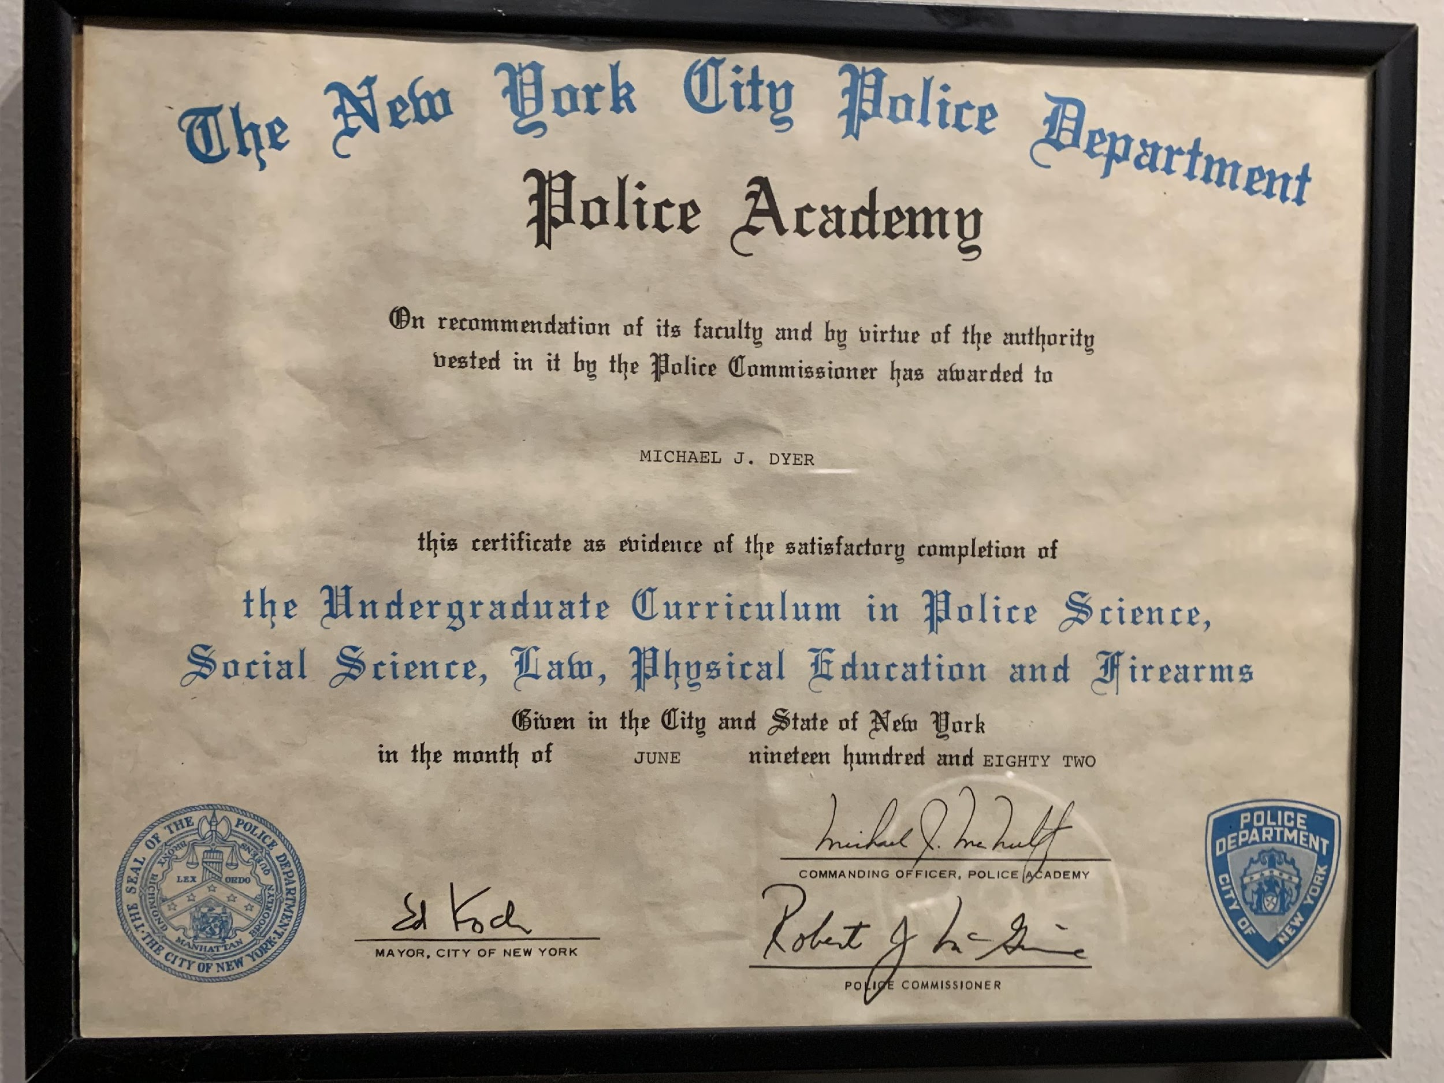
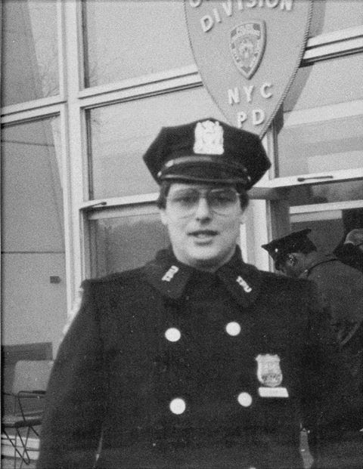
JANUARY 1982 – DECEMBER 1985: NYPD
After 4 years I was retired on a permanent total disability due to a line of duty injury.

Slide 24
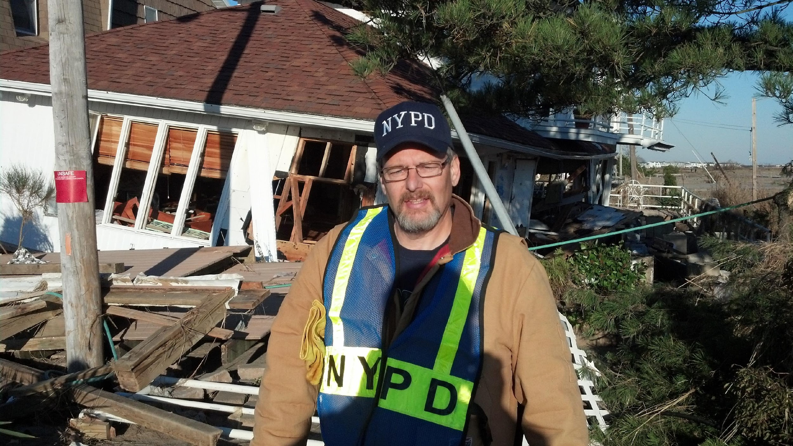
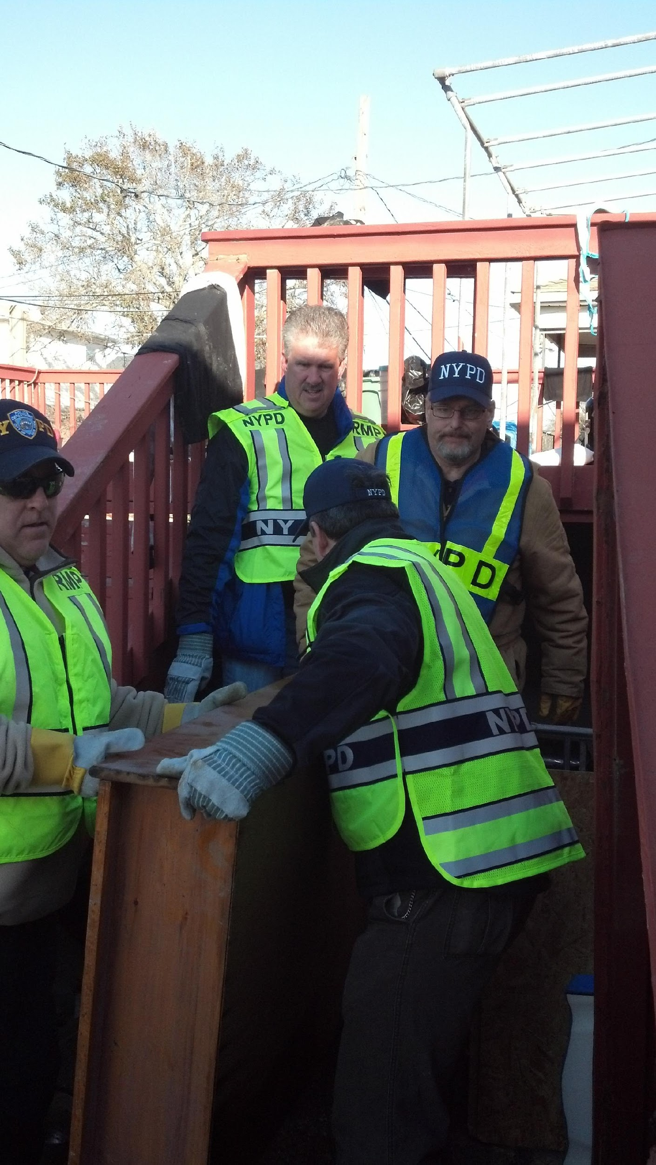
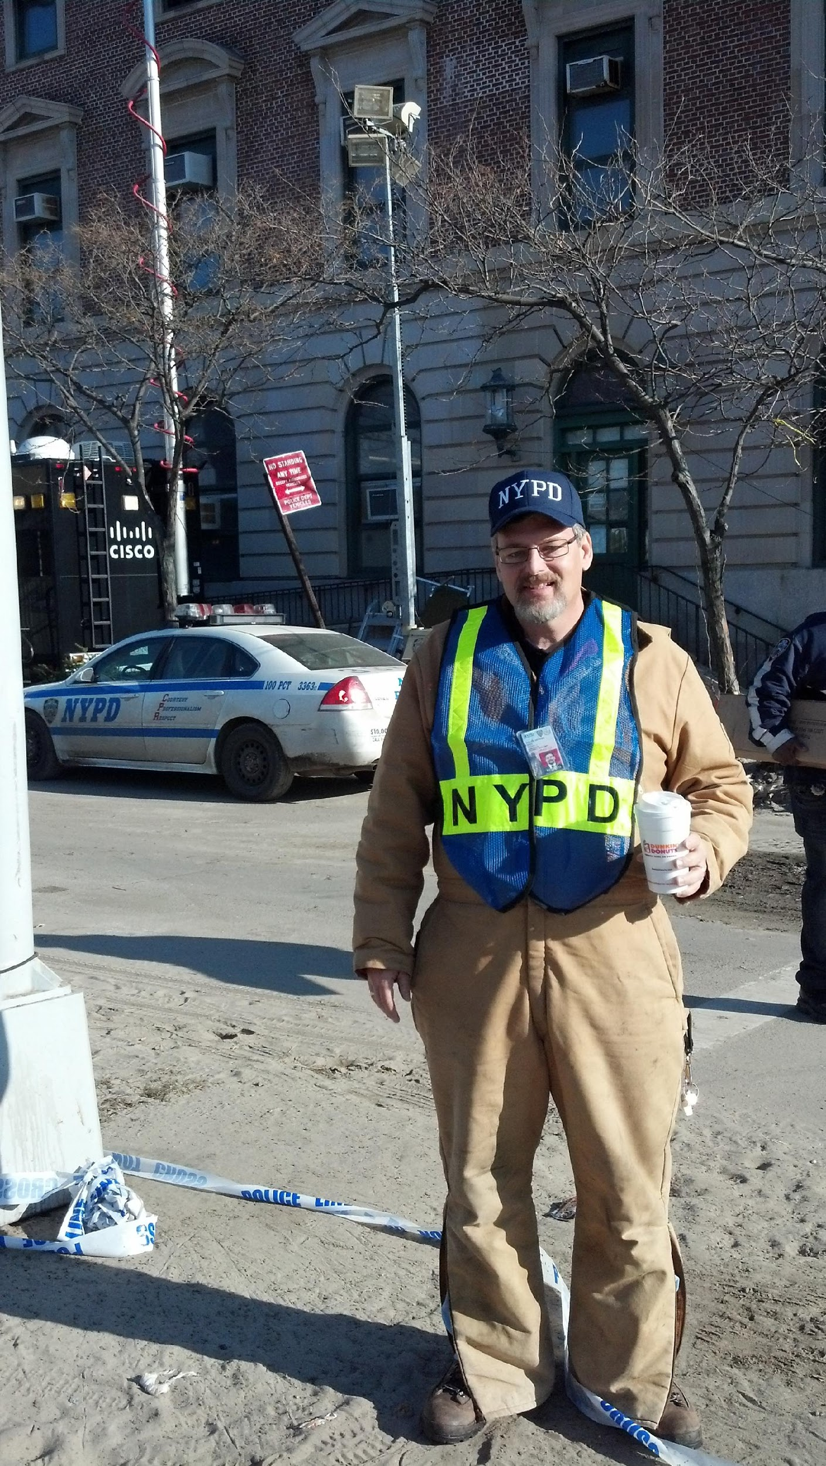
MY RETIREMENT
Returned to School and moved to Nebraska to attend Creighton School of law in 1987
Still active in a few NYPD organizations
Emerald Society NYC to march in the St. Patrick’s Day parade for the 38th consecutive time
Member of the Retirees Mobilization Plan that was set up after 9/11 for future terrorist or other states of emergency and have been back for training and intelligence briefing.
The plan was activated for the 1st time and only time so far in November 2012 for Super Storm Sandy

Slide 25
POPPA
Police Organization Providing Peer Assistance started in 1995 when 26 officers had completed suicide in two years
They listen, talk, and assist their fellow officer, when required, in securing the right professional services.
A network of clinicians, psychologists, doctors & counselors are available.
POPPA is set up for 100,000 NYPD active & retired members who all have the same insurance.
I applied for the POPPA program in 2008, passed the interview process, completed the basic 38 hour course and have attended numerous spring & Fall training seminars in New York

Slide 26
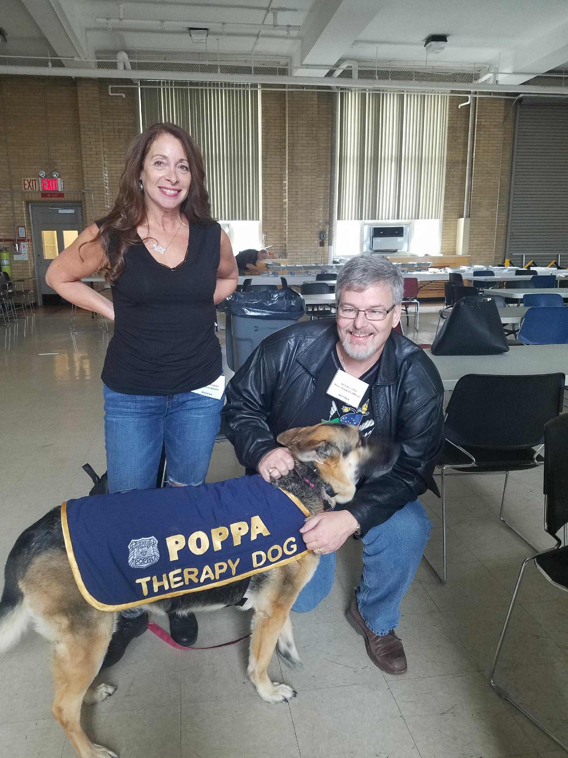
POPPA TRAINING

Slide 27
POPPA CONT.
The POPPA Organization has begun to change the way officers think about reaching out for help.
Cops traditionally have tended to think of themselves as problem-solvers, not as people with problems.
Can anyone think of another group of professionals that might think that way
Many have considered counseling as stigmatizing and career-threatening. Seeking support and averting a crisis is a sign of strength, not weakness.
Help the strong stay strong

Slide 28
HARD QUESTIONS
What are we dealing with as attorneys?
How many people have had a client complete suicide?
Does anyone know of an attorney who might have?

Slide 29
WHY WE DO THIS
I became a cop to help people, I became a lawyer to help people.
We do some things really well, but not everything and need to know limitations.
We are not therapists, clinicians, or medical doctors, so we have to know limitations
We do not possess the skill set or training to fix the problems we are confronted with and we need to remember that for ourselves and to tell that to the client.

Slide 30
LET’S LOOK AT THE LAW
Rule 1.6: Confidentiality of Information
Client-Lawyer Relationship
(a) A lawyer shall not reveal information relating to the representation of a client unless the client gives informed consent, the disclosure is impliedly authorized in order to carry out the representation or the disclosure is permitted by paragraph (b).
(b) A lawyer may reveal information relating to the representation of a client to the extent the lawyer reasonably believes necessary:

Slide 31
Client-Lawyer Relationship- Continued
(b) Continued:
to prevent reasonably certain death or substantial bodily harm;
(2) to prevent the client from committing a crime or fraud that is reasonably certain to result in substantial injury to the financial interests or property of another and in furtherance of which the client has used or is using the lawyer's services;
(3) to prevent, mitigate or rectify substantial injury to the financial interests or property of another that is reasonably certain to result or has resulted from the client's commission of a crime or fraud in furtherance of which the client has used the lawyer's services;
(4) to secure legal advice about the lawyer's compliance with these Rules;

Slide 32
(b) Continued:
(5) to establish a claim or defense on behalf of the lawyer in a controversy between the lawyer and the client, to establish a defense to a criminal charge or civil claim against the lawyer based upon conduct in which the client was involved, or to respond to allegations in any proceeding concerning the lawyer's representation of the client;
(6) to comply with other law or a court order; or
(7) to detect and resolve conflicts of interest arising from the lawyer’s change of employment or from changes in the composition or ownership of a firm, but only if the revealed information would not compromise the attorney-client privilege or otherwise prejudice the client.
(c) A lawyer shall make reasonable efforts to prevent the inadvertent or unauthorized disclosure of, or unauthorized access to, information relating to the representation of a client

Slide 33
To prevent reasonably certain death or substantial bodily harm
Nebraska rule states that for purposes of Rule 1.6 , a lawyer-client relationship shall exist “between a member of the Nebraska State Bar Association Committee on the Nebraska Lawyers Assistance Program or an employee of the Nebraska Lawyers Assistance Program and a lawyer who seeks or recieves assistance though that committee or program
Disclosure: Preventing Death of Bodily Harm

Slide 34
I SPOKE TO NEBRASKA COUNSEL FOR DISCIPLINE.
There are no advisory opinions or case law in Nebraska that they are aware
They get regular calls from attorneys asking for advice from primarily family law attorneys followed by criminal defense attorneys and attorneys from many other fields

Slide 35
THERE ARE TWO WAYS TO LOOK AT THE WORD “MAY”…
MAY OR MAY NOT

Slide 36
ATTORNEY VIEWS OF SUICIDE
A rang of views from “you’re just talking silly” or “if your going kill yourself take it out of my office” to…
I want to help
Clients come to see us for an event in their lives they will never forget

Slide 37
THERE’S AN EXPRESSION I HEARD…
It’s not the dirty plates in the sink that makes someone lose their cool it’s all the stuff that leads up to that.

Slide 38
WE TAKE OUR CLIENTS THE WAY WE FIND THEM
Some living paycheck to paycheck
Some have dysfunctional home lives
Now add the injury or criminal; case or divorce
These people are not coming in to share the joy in their lives with a stranger

Slide 39
YOU ARE AN ATTORNEY & COUNSELLOR AT LAW
WE ALL KNOW THE ATTORNEY PART AND THE NUTS AND BOLTS OF HOW TO PRACTICE… BUT
WHAT IS THE COUNSELOR PART?

Slide 40
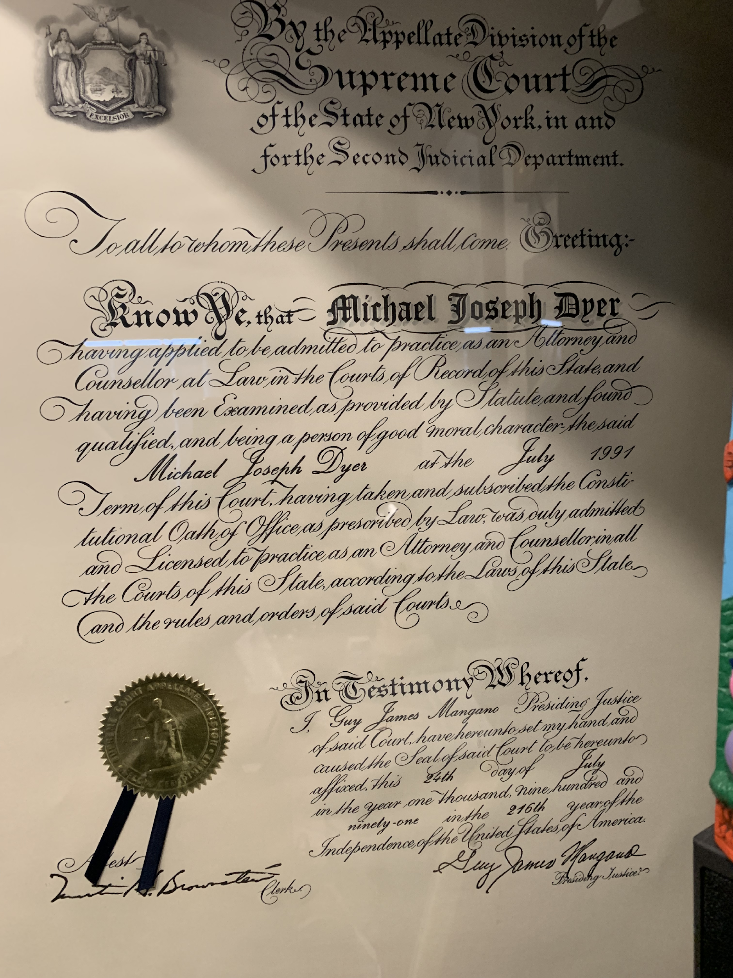

Slide 41
WE ALL KNOW THERE ARE PRIVILEGES
Martial
Medical doctor patient
Clergy
Attorney /client privilege
What is disclosed is held in confidence
so that people may get the help they need

Slide 42
A CLIENT DROPPED BY MY OFFICE
Wanted to bring a slander case
Wrongfully accused of elder abuse, Accused of taking money that he assures me he had permission to use
After some discussion I called Bill McGinn to set up an appointment about the possible criminal issues he might be facing
Client said: “I might as well kill myself”

Slide 43
HOW I TALKED TO THIS CLIENT
I asked a few questions: the client just wanted to figure out a way to kill himself withough it hurting much
I asked about prior attempts, there were some, prior hospitalizations
I asked more questions and let him talk for about 20 minutes
I told him this was a serious matter and asked if he might want help
I suggested I call the police, he said if they come he will tell them he’s not suicidal and they won’t take him- he’s right

Slide 44
AFTER THE CONVERSATION
Told him to drive right to VA & check himself in, he had many things to take care of but when he did get them done, he would
I called him 2 hours later, he was still busy getting things done
Left voicemail before I left the office
I called next day, right to voicemail, same for the next couple of days
I called the next week & he answered, had checked himself in.

Slide 45
HOW I TALK TO MY CLIENT
I call each of my client who have not had contact with my office every month or so.
Very simple “Hi, this is Mike, just wondering how you’re doing.”
Talking to a 40 year old who was home for 2 months recovering from spine surgery
He was feeling better but couldn’t pay his bills.
He’s getting short with his loved ones.
I actively listen and use his words in asking questions.

Slide 46
HOW SHOULD YOU TALK TO A POTENTIALLY SUICIDAL CLIENT
Forget about the case and focus on the client.
Are you feeling depressed?
Check list?
Are you a veteran (VA)
Are you religious (Clergy)
Make a plan

Slide 47
ANOTHER INSTANCE OF SUICIDE PREVENTION
Talking to an attorney about a case on a Monday morning, asked how things were going
“Well I had a choice between coming to work or going downstairs and getting my gun so I came to work”
It’s a busy Monday for me, I’ve got things I’ve got to get done
I knew enough that a comment like that could be a red flag
I asked him a few questions about that comment, got evasive type answers and asked a few more.
Told him that it sounded like a problem to me,
If he broke his arm he would get that treated and the potential outcome of this problem would be much worse
I agreed to meet for coffee and after visiting for a while we drove over to Immanuel where the attorney was evaluated and agreed to check himself in

Slide 48
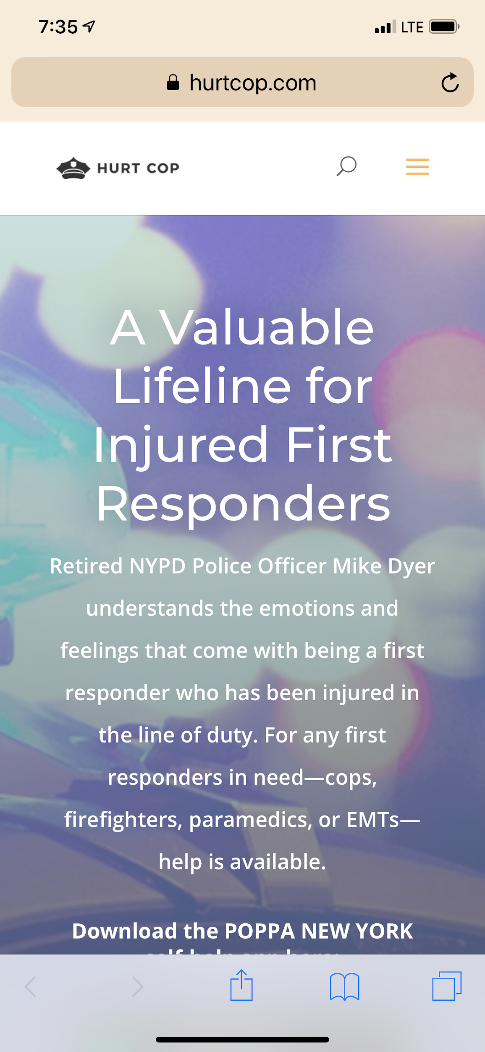
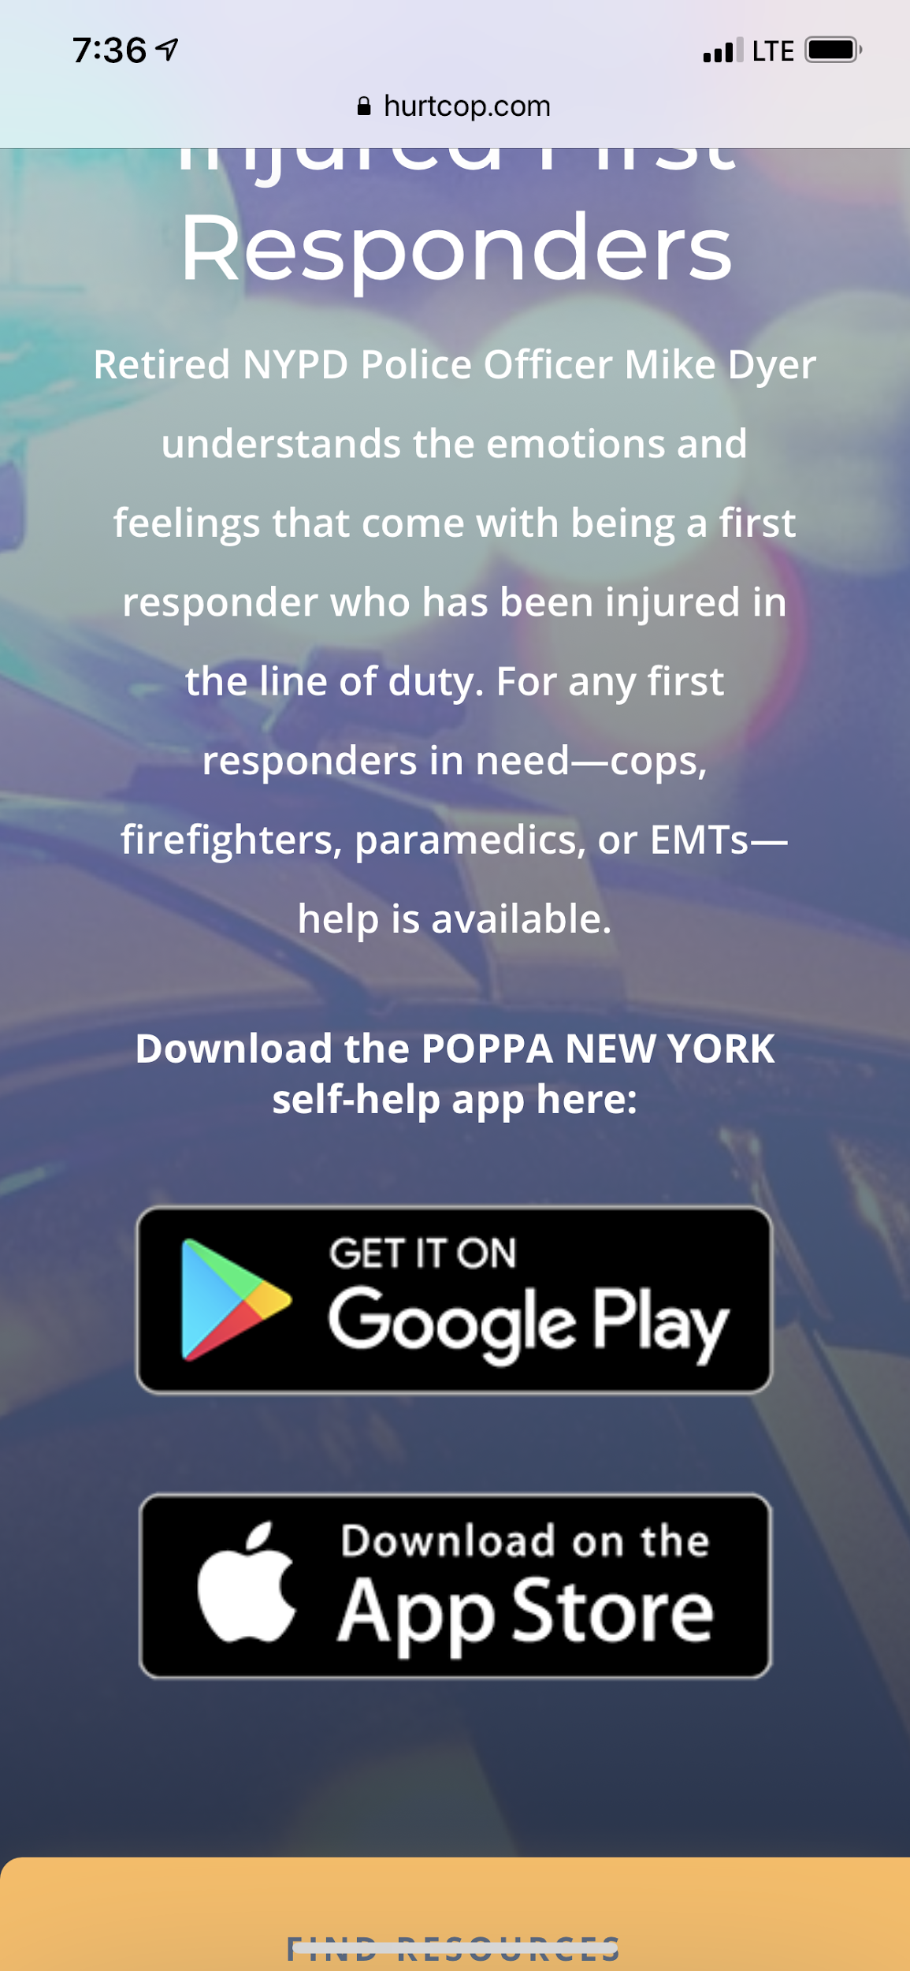

Slide 49
Be aware of your own personal issues, get help as needed.

